Slide 1
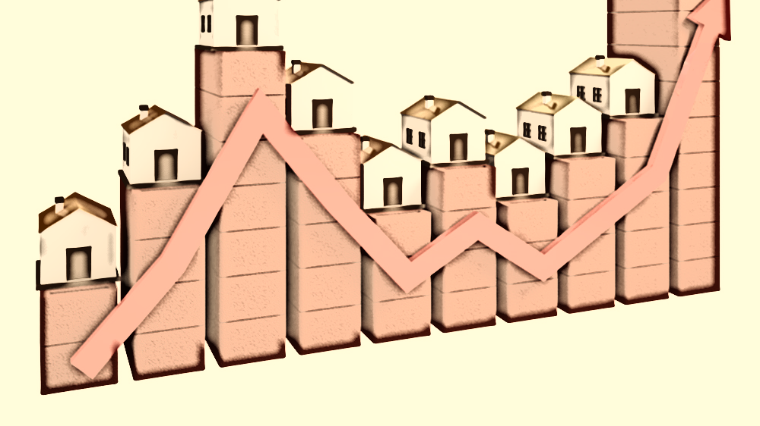
Melbourne Housing Analysis
Student Name: Suhong Liang
Student ID: 200398798
Instructor: Shannon Mulligan

Slide 2
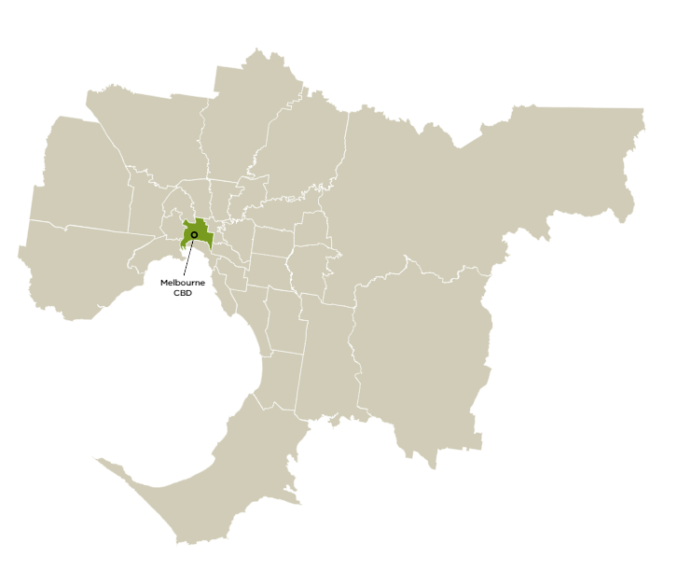
About Melbourne…
The median house price has increased by 3 times from 2000 ($0.3M) to 2016($1.2M)
Melbourne, the capital of the state of Victoria, is one of the world’s most liveable cities.
Metropolitan Melbourne, spanning over 9990 km² , is home to 4.9 million people.
Melbourne is the most multicultural city of Australia, with nearly 50% of residents born overseas.
With the growing markets, the real-estate has been blessed with its demand in Melbourne.
Selecting a best place to live and choosing the best time to buy with an affordable budget becomes a challenge to all.
https://liveinmelbourne.vic.gov.au/discover/melbourne-victoria/metropolitan-melbourne#
https://data.melbourne.vic.gov.au/Property-Planning/Median-House-Prices-by-Transfer-Year-from-2000-201/67fb-mvax
Notes:
Quality of analysis on the historical housing data, to dive deeper and understand the factors contributing to the price of the house.
This analysis aims to provide the answer for the above questions, using the data of the real-estate market in Melbourne from 2016-2018

Slide 3
Data Description
Datafile: Melbourne_housing_FULL.csv
Data Range: Jan. 2016 to Oct. 2018
No. of variables: 21
No. of records: 34,857
Missing data: 26,022
No. of records in clean data: 7095
Some new variables will be added, such as PriceRange, MethodGroup, BedroomGroup, DistanceGroup, and HouseAgeGroup
Dimensions: Regionname, Type, Date(Year and season), Address
Measures: Price, Bedroom2, Distance and HouseAge
Variable | Type
Suburb | Char
Address | Char
Rooms | Num
Type | Char
Price | Num
Method | Char
SellerG | Char
Date | Num
Distance | Char
Postcode | Char
Bedroom2 | Num
Variable | Type
Bathroom | Num
Car | Num
Landsize | Num
BuildingArea | Num
YearBuilt | Num
CouncilArea | Char
Lattitude | Num
Longtitude | Num
Regionname | Char
Propertycount | Char
Data Source:
https://www.kaggle.com/anthonypino/melbourne-housing-market
Notes:
Here is the information of the dataset I used.

Slide 4

Business Questions
Which are the Top 3 regions that people like to buy their house?
Which region to buy a house is cost you more money?
What are the dominant markets for house Type, bedroom, distance, and house age in terms of sales, respectively?
What’s the most important factor affects the price of a house?
Where to buy a house in dominant housing market?
When to buy a house next year?

Slide 5
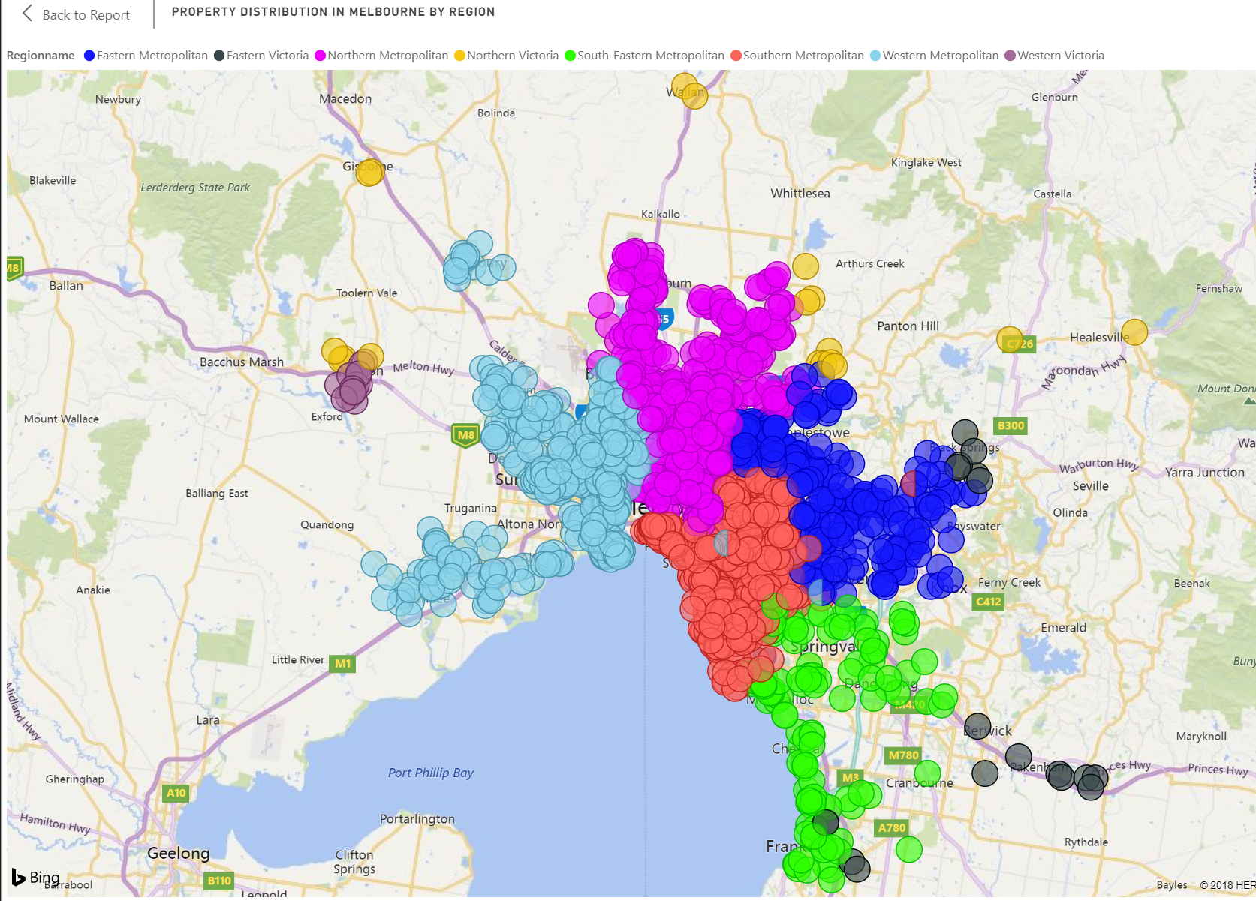



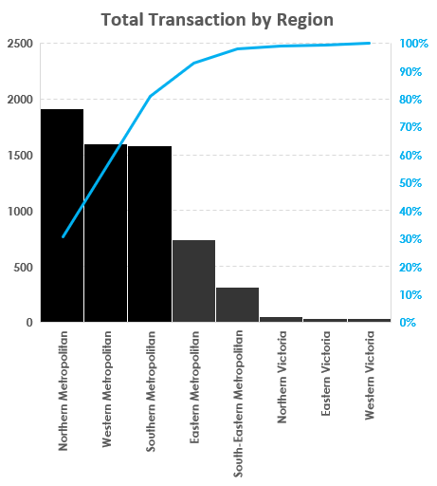
Distribution of Total Transaction by Region
Top 3: property counts are over 80%
CBD
Notes:
Which regions that people in Melbourne are more likely to buy a property?
Northern/ western/southern Metropolitan are the top 3 regions that consist over 80% of sold properties during 2016 to 2018.

Slide 6

Average Sale Price By Region
Southern Metropolitan:
Highest avg sale price ($1.6 Million).
≈ 2 times of the avg price of the remain regions ($0.8 Million).
With large amount of properties sold but the avg sale price are the lowest among these five main Metropolitan regions
* Only sold properties are considered in this analysis
Notes:
Which region to buy a house is most expensive?

Slide 7
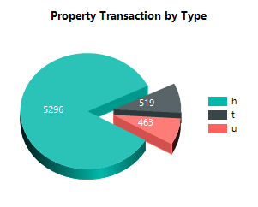
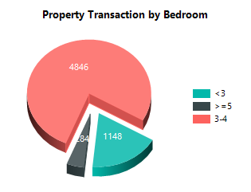
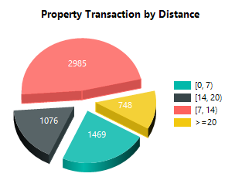
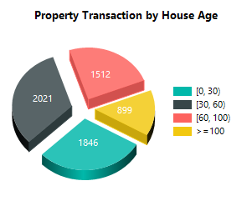
Dominant Segments In Terms of Sold Properties
Dominant segments in the Real estate market:
Type: h _ house (semi-detached and detached)
- 84%
Bedroom: 3-4
- 77%
Distance: within14 kms from CBD(Central Business District)
- 71%
House Age: < 60 years old
- 61%
77%
84%
8%
7%
5%
18%
Fig.
48%
24%
12%
32%
14%
17%
23%
29%
* The pie charts are done by SSRS
Notes:
What kind of property are more popular in the housing market in Melbourne? For example, what ‘s the type of the property dominate the market? How many bedrooms of the house people prefer to buy?
How far the distance of the house from CBD people are more likely to buy? To ans this question, I create a pie chart in SSRS. As the charts shows, 84% of the property sold in the market is house, include semi-detached and detached house. 77% of the house sold in the market is a house with 3-4 bedrooms. 71% of the house of distance from CBD within 14 km, and 61% of the houses are with age less than 60. overall, a house with 3-4 bedrooms, of distance from CBD within 14kms and whose age is less than 60 years old is dominate the real – estate market in Melbourne

Slide 8
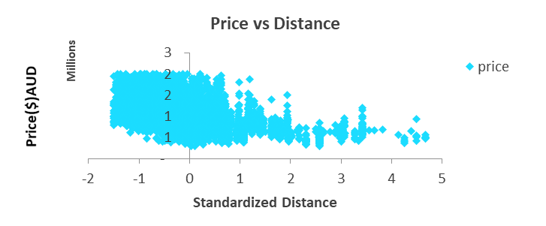
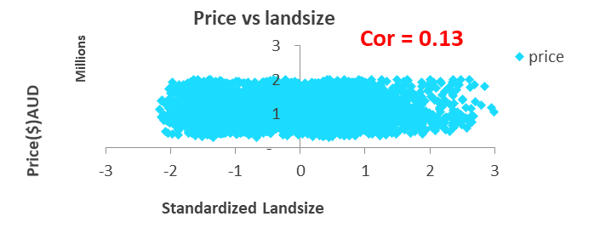
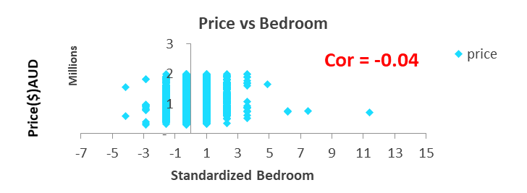
What is the most important factor that affects the price of a house?
Price is inversely proportional to distance.
Distance increase House price would be lower
Cor = -0.50
Multiple Linear Regression Model:
House Price = -254461.62*Distance + 79778.19*Bedroom + 79686.24*LandSize
** F-significant = 0.00 : the model is significant
Distance is the biggest contributor to house Price
“Sacrificing” the distance can significantly save your budget to buy a house
Note: before doing the analysis, we use z-score to standardize the distance, landsize and bedroom
http://blog.minitab.com/blog/adventures-in-statistics-2/how-to-identify-the-most-important-predictor-variables-in-regression-models
Notes:
After inspecting the relationship between price and 3 independent factors(*): distance, number of bedroom and land size, it is shown that the house price is significantly related to distance. The biggest abs coefficient shows that the house price is largely affected by distance. For a tight budget, distance is the very first option to be “sacrificed” in order to get the desired deal
(*) Using correlation and regression models

Slide 9
Where to Buy a 3-4 Bedroom House -Target Regions
Southern Metropolitan
Avg price: $1.5 Million
2016-2017: +4%
2017-2018: +8%
Northern Metropolitan & Western Metropolitan
Avg price: $ 0.7 Million
2016-2017: -15%
2017-2018: +1% / -3%
* This analysis focus on the dominant segments: Bedrooms 3-4 bedroom; Type: h; House age: < 60 yrs
Notes:
The house price is Dramatically decline from 2016 to 2017 about 15% however, from 2017 to 2018,
However this downward trend Slow down during 2017 to 2018

Slide 10
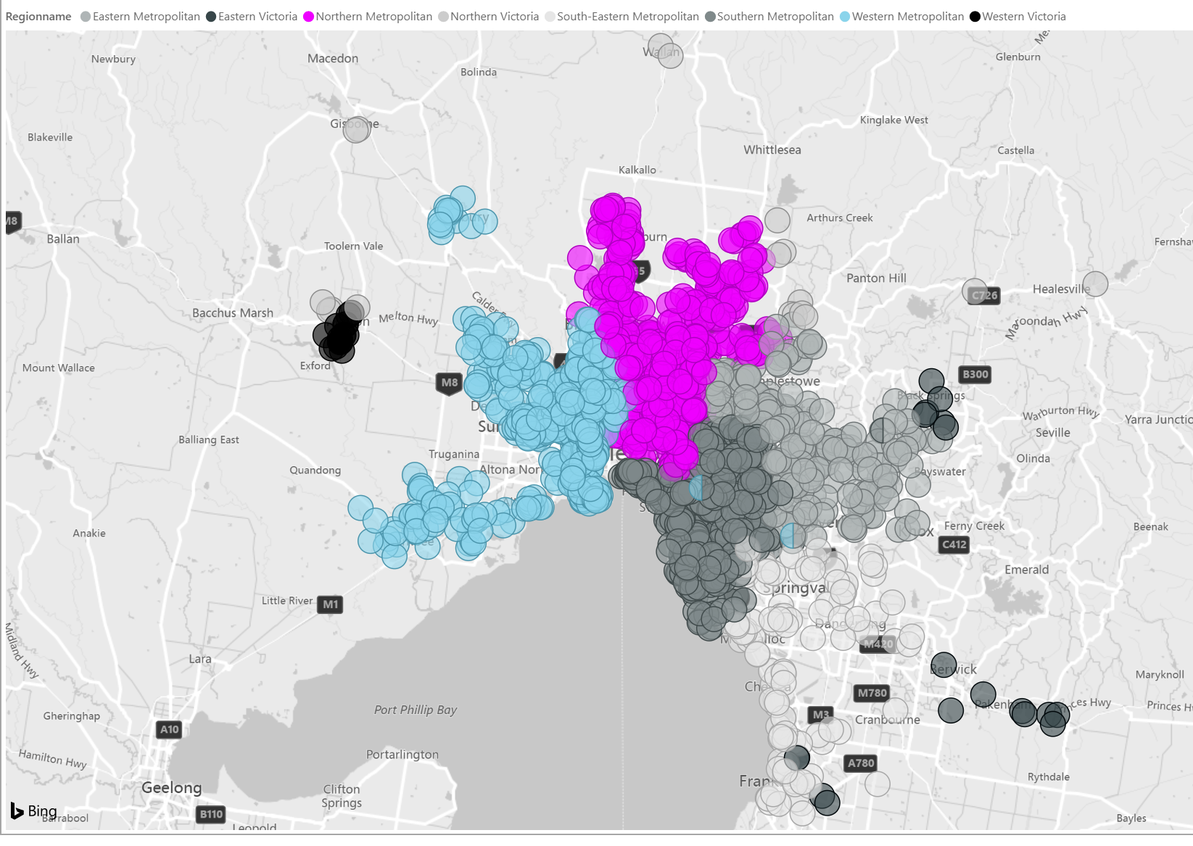
Where to Buy a 3-4 Bedroom House -Target Regions
CBD
Target Regions:
Northern Metropolitan & Western Metropolitan
Close to CBD
Lowest Avg Sale Price
The price become steady since 2017

Slide 11
Where to buy a 3-4 bedroom house - Potential Suburbs in Northern Metropolitan
Region Average Price
Potential suburbs in Real Estate Market:
Positive growth rate
Avg sale price < Region avg sale price
* This analysis focus on the dominant segments: Bedrooms 3-4 bedroom; Type: h; House age: < 60 yrs

Slide 12
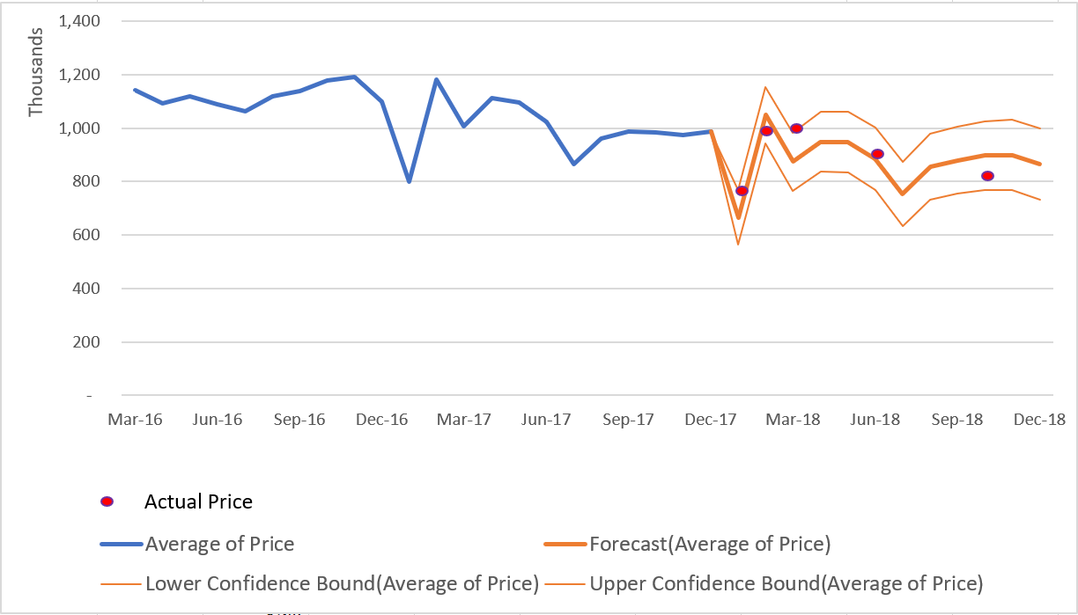
When to buy a house next year? - For buyer interested in low to high price segment
Melbourne Housing Market 2018 Prediction
Jump up to the peak
Overall, 12% decline is expected in the sale price in 2018
The best time to buy a house is in January / July, which can buy a house in a lower price
Avg Price (AUD)
Similar pattern
Reach the bottom price
* Forecast based on time series model of the monthly data in 2016 & 2017
Notes:
Overall, the housing market in Melbourne is expected to be on a downward trend, as price in the forecast of 2018 will decrease by 12% compared to the average price in 2017.
The best time recommended to buy a house is in January when the price is predicted to reach the bottom of the entire year. However, the price is expected to jump up to the highest point in the following month (February).

Slide 13
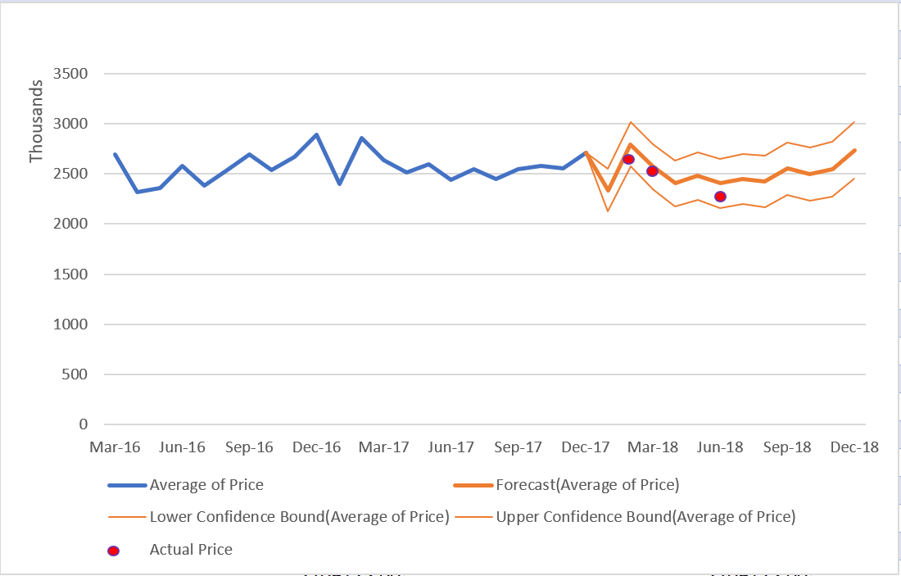
When to buy a house next year? - For buyers interested in luxury segment
:
Housing Market 2018 Prediction - Luxury Segment
A slight decline (2%) of avg price is predicted in 2018
Similarly, the best time to purchase a luxury house in January
Avg Price (AUD)
The overall trend is more steady in luxury segment.
slightly fluctuate between $2 million and $3 million.
* Forecast based on time series model of the monthly data in 2016 & 2017
Notes:
It is predicted that houses in Luxury segment will suffer a decline of average 2% in 2018.
Similarly to the trend in general segments, for buyers interested in making long term investment, it is advisable that they should make purchasing decision at the beginning of the year right before the peak price in February.

Slide 14
Conclusion
The Northern /Western/Southern Metropolitan are the top 3 regions that consist of over 80% sold houses.
Southern Metropolitan is the most expensive area to live in, with average price 1.5 Million AUD, around 2 times of the average price of the remain regions.
The house with type h, 3 to 4 bedroom, house age less than 60 years and distance from CBD within14 kms is the most popular property in Melbourne.
Based on the dataset of the housing market in Melbourne, it is proven that distance is the biggest factor that affects the price of the house.
Buying a house whose age is less than 60 yrs and with 3-4 bedrooms, you should search it in Northern Metropolitan and Western Metropolitan.
The prediction shows that the market in 2018 is on a decline trend, however, it can be a good time for investors to make long-term investment as the price will largely decrease in January.
Finally, despite the gloomy forecast of the real estate market in Melbourne, there are some potential areas where house price still has a lot of room to increase.

Slide 15


